Slide 1
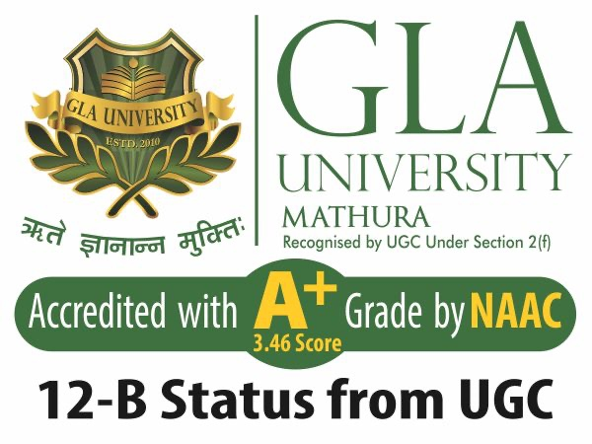
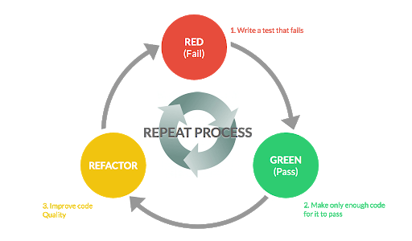
Agile Software Development
Topic: Code Refactoring
Dr. Nikhil Govil
Associate Professor, Program Coordinator – B.Tech. (CSE), Dept. of CEA

Slide 2

Topics to be covered
Code Refactoring
Why to refactor a code?
Process of code refactoring
Benefits of code refactoring
Code refactoring techniques

Slide 3
Code Refactoring
Code refactoring is the process of restructuring existing computer code without changing its external behavior.
While refactoring new code is not developed rather improvement of the existing code is focused.
Refactoring improves non functional attributes of the software.
Advantages include improved code readability and reduced complexity to improve source code maintainability, and create a more expressive internal architecture or object model to improve extensibility.

Slide 4
Why to Refactor a Code?
There may be some stereo-typical situations where program code should be improved. Such situations are known as Code Smells. Some of them are:
Duplicate Code
Long Methods
Switch Case Statements
Data Clumping &
Speculative Generality.

Slide 5
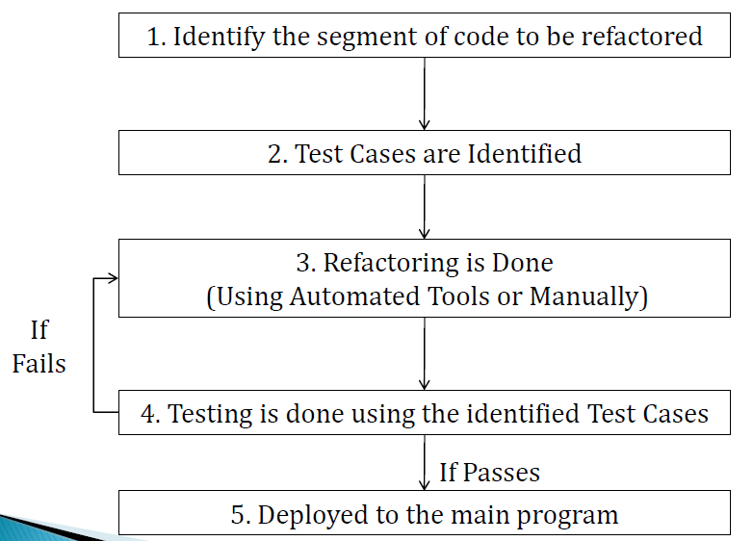
Process of Code Refactoring

Slide 6
Benefits of Code Refactoring
1. Maintainability
It is easier to fix bugs because the source code is easy to read and the intent of its author is easy to grasp.
2. Extensibility
It is easier to extend the capabilities of the application if it uses recognizable design patterns, and it provides some flexibility where none before may have existed.

Slide 7
Code Refactoring Techniques
Techniques that allow for more abstraction
Encapsulate Field: force code to access the field with getter and setter methods
Generalize Type: create more general types to allow for more code sharing
Replace type checking code: with State/Strategy
Replace conditional with polymorphism

Slide 8
Code Refactoring Techniques
Techniques for breaking code apart into more logical pieces
Componentization breaks code down into reusable semantic units that present clear, well defined, simple to use interfaces.
Extract Class moves part of the code from an existing class into a new class.
Extract Method, to turn part of a larger method into a new method. By breaking down code in smaller pieces, it is more easily understandable.

Slide 9
Code Refactoring Techniques
Techniques for improving names and location of code
Move Method or Move Field move to a more appropriate Class or source file.
Rename Method or Rename Field changing the name into a new one that better reveals its purpose.
Pull Up in OOP, move to a super class.
Push Down in OOP, move to a sub class.

Slide 10
References
Ken Schawber & Mike Beedle, Agile Software Development with Scrum, Pearson, 2008.
Robert C. Martin, Agile Software Development, Principles, Patterns and Practices, Prentice Hall,2002.
Lisa Crispin & Janet Gregory, Agile Testing: A Practical Guide for Testers and Agile Teams, Addison Wesley, 2008.
Alistair Cockburn, Agile Software Development: The Cooperative Game, Addison Wesley, 2006.

Slide 11


